Slide 1


Zoom for dummies
(by your lovely TAs)

Slide 2

Setup & features

Slide 3

Setup
Create an account on Zoom here (please put your full name for now !)
Download and install Zoom here
If the email address you use for Zoom is different from the one you gave to Ironhack, please tell us!

Slide 4
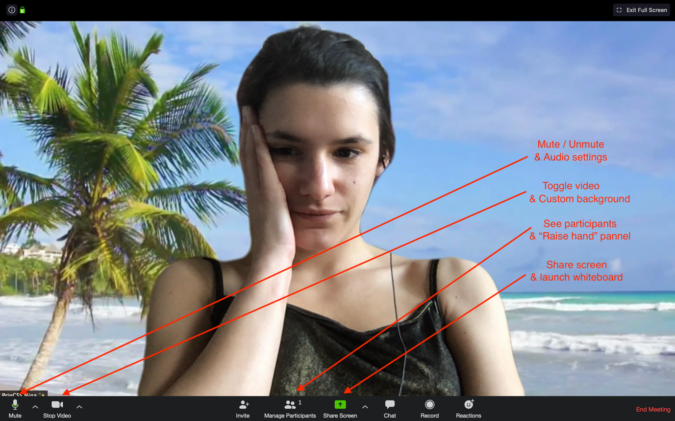
Features
Here are some basic features that you will use:

Slide 5
Join the class

Slide 6
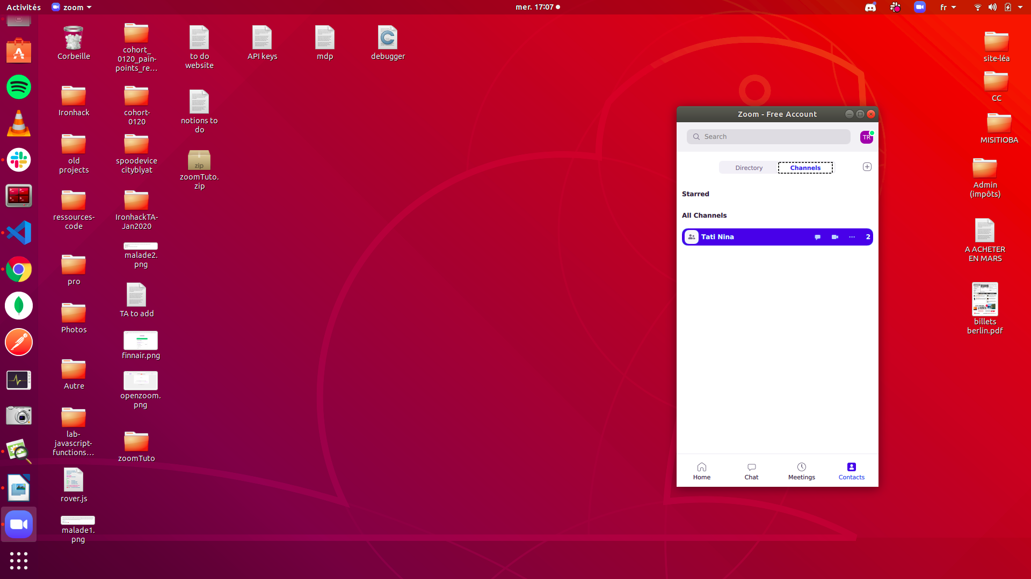
With the open app
When in the app, you will receive an invite to join the channel for the class
Once you joined in, you will see it appear whenever you launch Zoom, in the “Contacts” tab

Slide 7
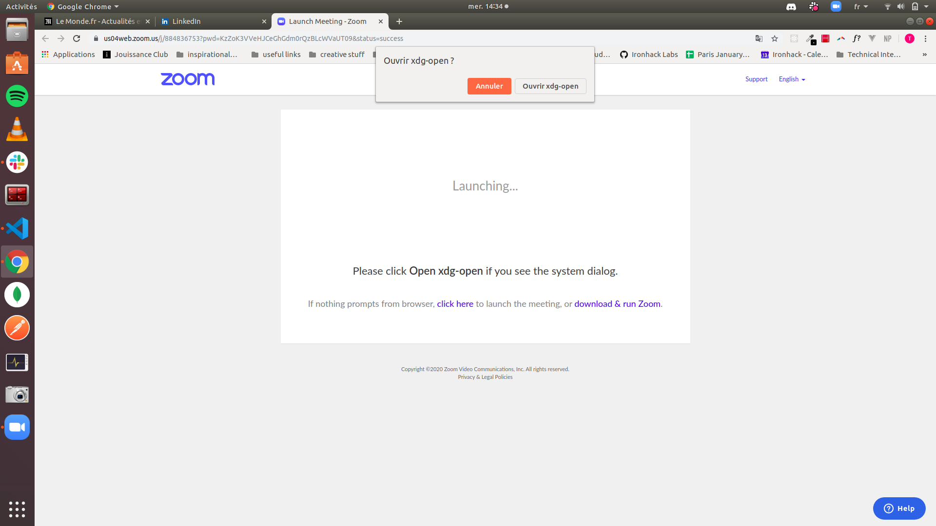
On Slack
When the class starts, you will receive an invite to join the meeting (we’ll post the link to the meeting on Slack, but since you’re working from home you shouldn’t have an excuse for being late !)
If you click on a link invite, you’ll be taken to the browser to accept and open the app.

Slide 8
Interactions

Slide 9
Microphones
You’ll be muted when the class starts.
Of course you can unmute yourself when needed, but please think about “raising your hand” instead of talking directly since we’re remote (if everybody starts speaking at the same time it’s going to be a mess!)
When in class, you can raise your hand if you have a question, the teacher and the TAs will be notified. Do not worry there is plenty of time to explain!

Slide 10
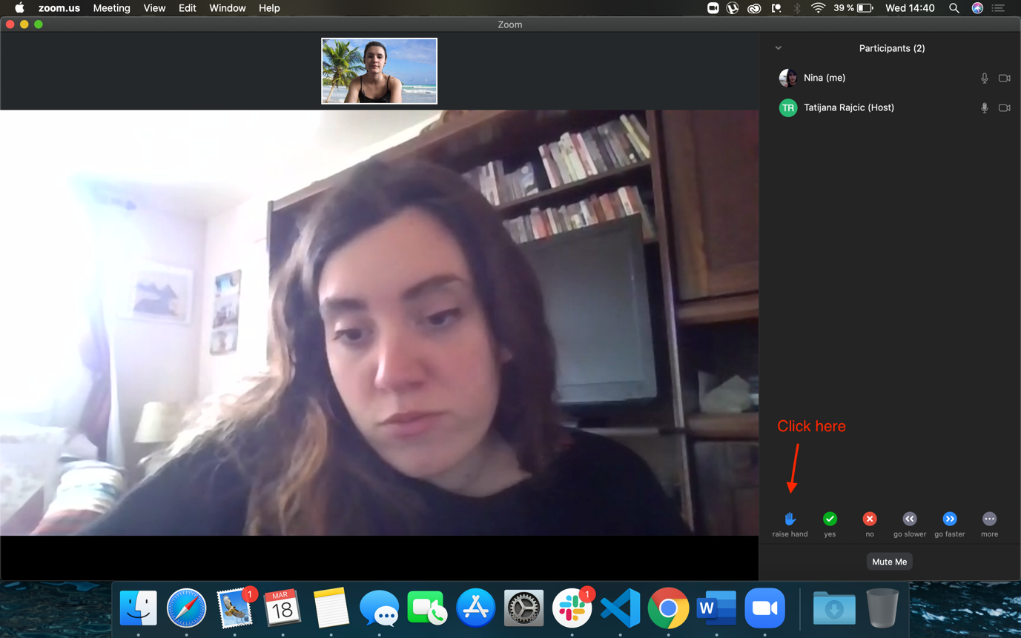
Raise Hand from student screen

Slide 11
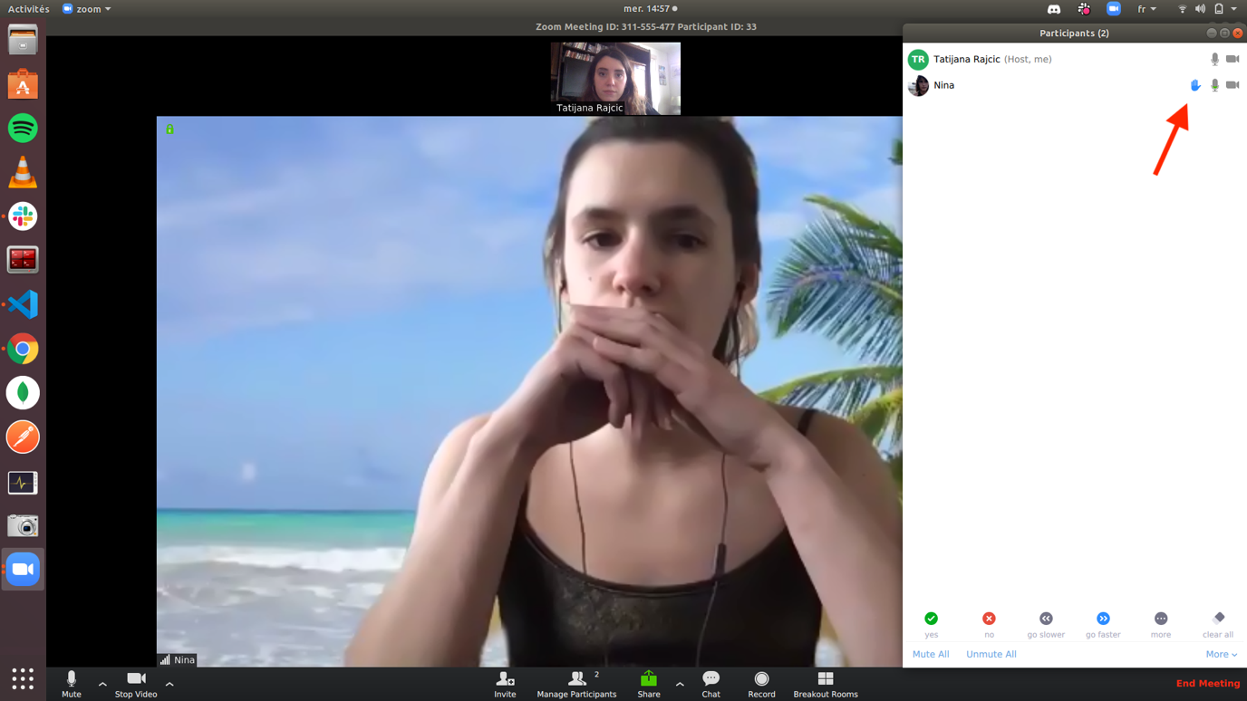
Raise Hand from teacher screen

Slide 12
Breakout Rooms

Slide 13
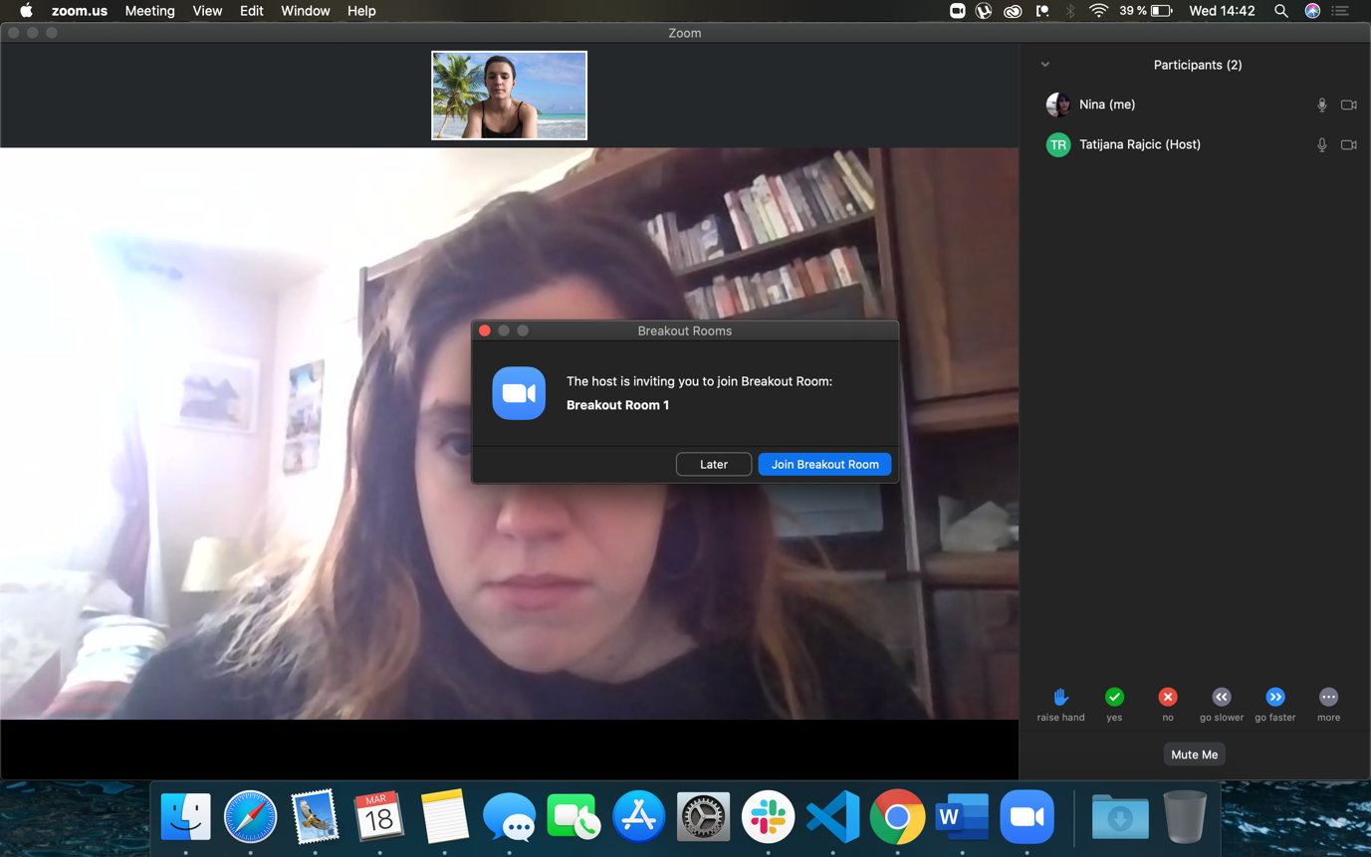
Invite to breakout rooms
You will be in separate rooms at various points in the day (labs in teams for example).
You will receive an invitation to join a breakout room from the teacher.

Slide 14
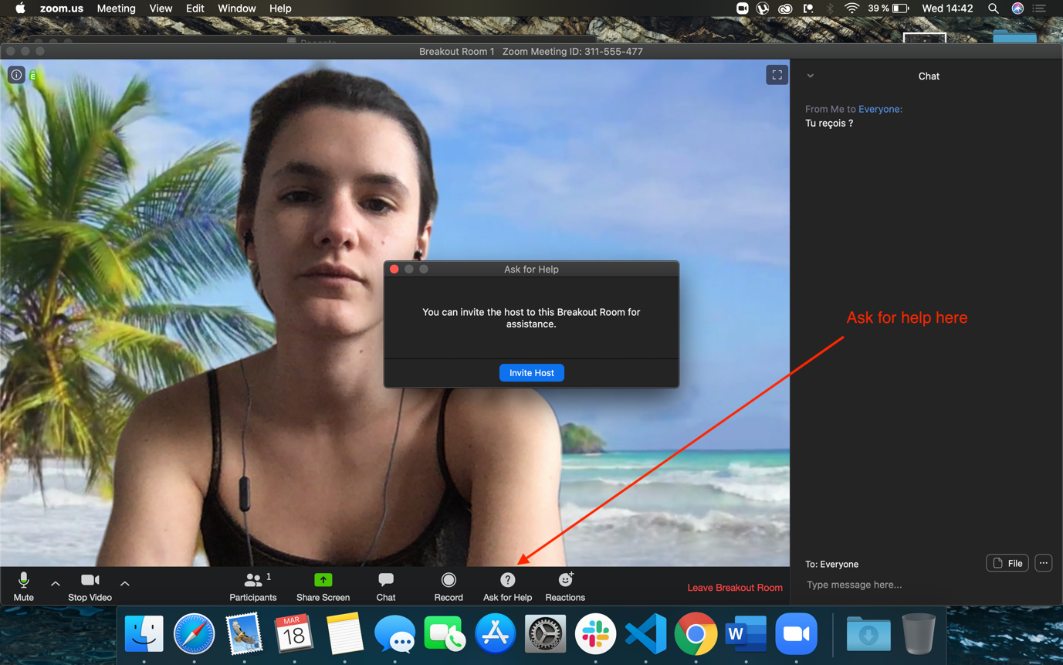
Once in a breakout room
Please note that when you join the breakout room, you will be taken out of the main room
You will still be able to return back and forth, and ask for help to the teacher and TAs

Slide 15
Debug & Screen Sharing

Slide 16
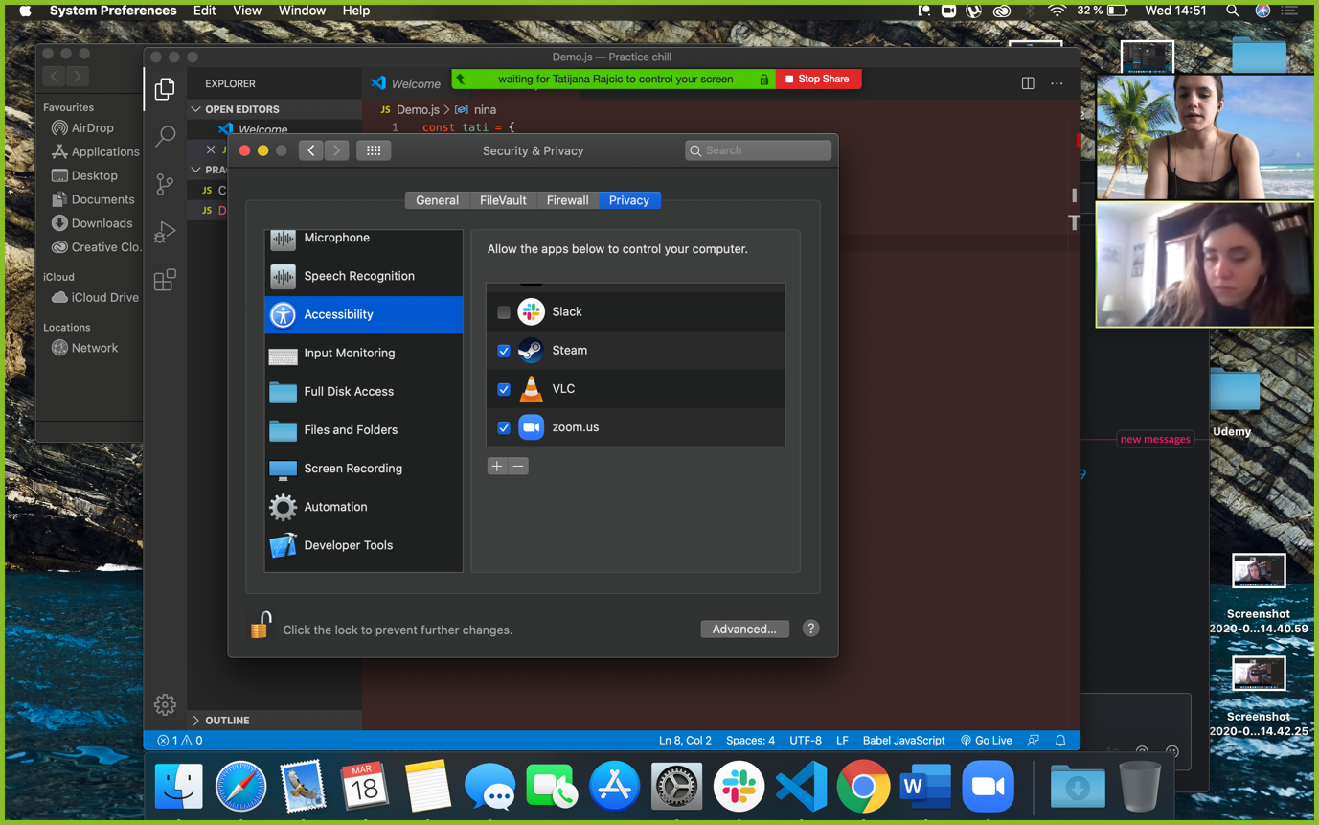
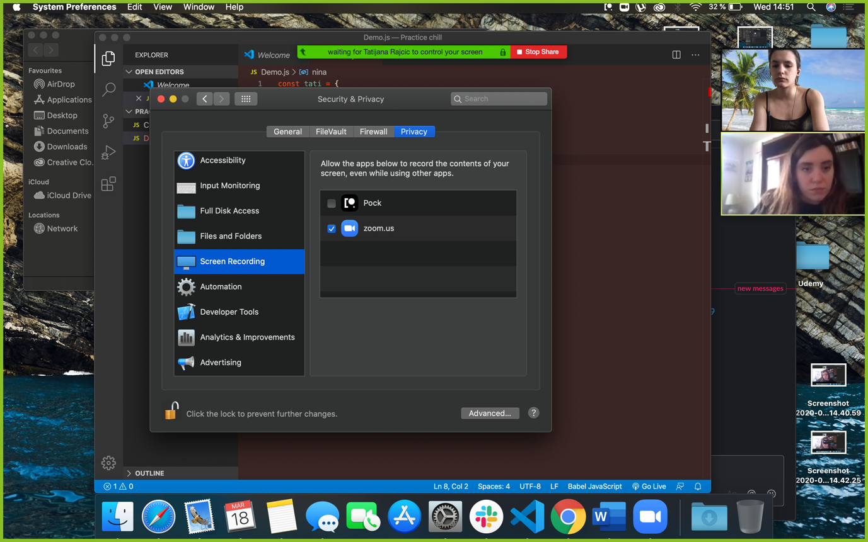
Screen Sharing settings
If at some point you need help on your code, it might be way easier to share your screen so we can help more efficiently.
Depending on your configuration, you might need to authorize Zoom to access your screen and input.
Here is an example for Mac users

Slide 17
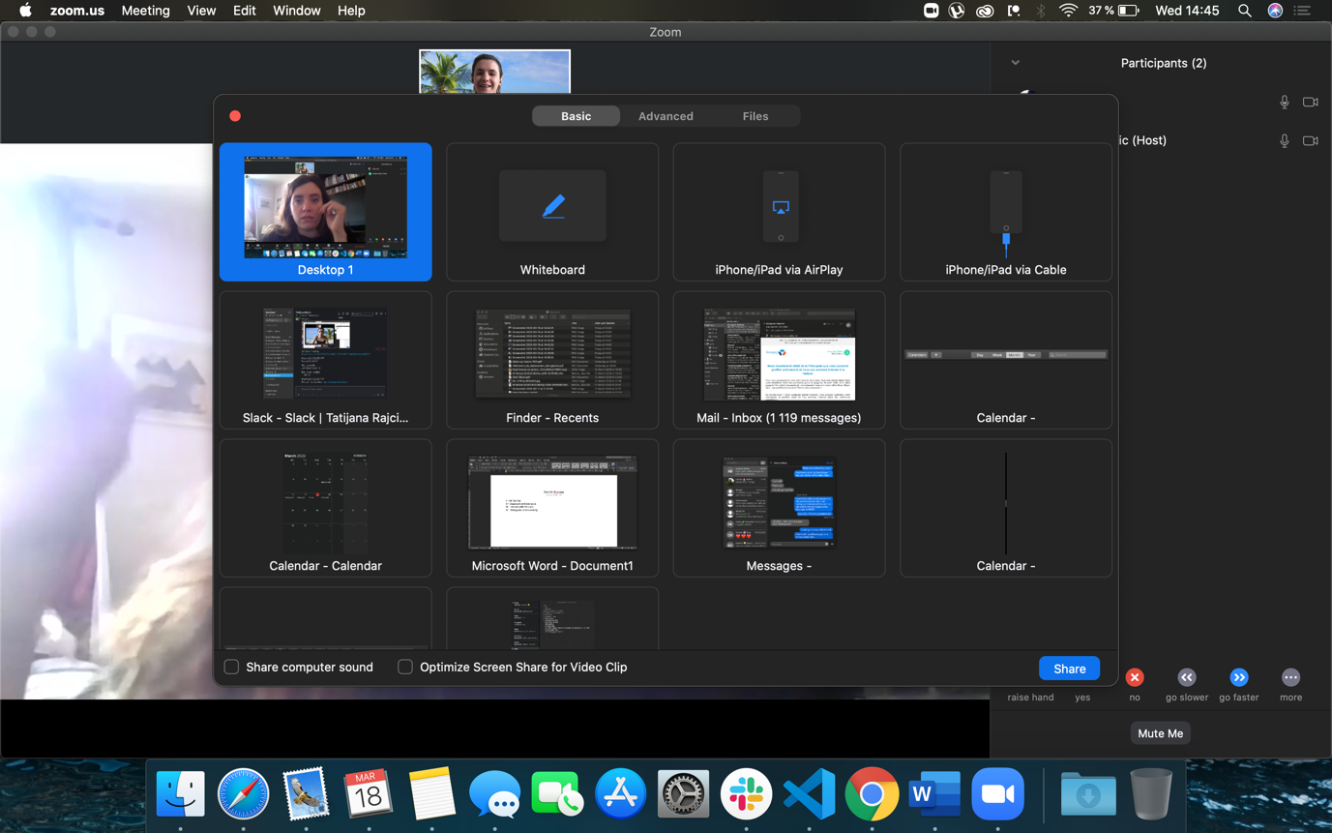
Best practice
The best way for us to help you debug would be to choose the option “Desktop” (and not just the window of your code) to access the browser for output, or in case of need for resources such as an article or previous exercises / lessons.

Slide 18
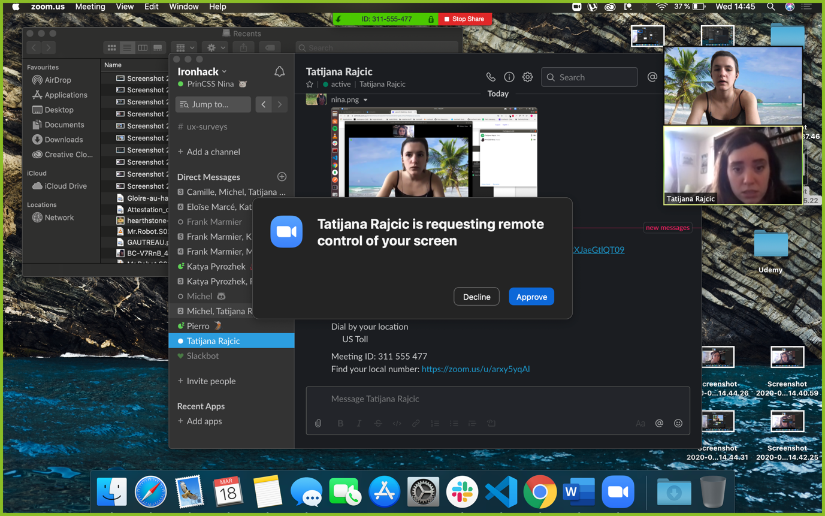
Remote control
You might also need to allow remote control if the teacher wants to write in your code or show you something specific.

Slide 19
Bonus

Slide 20
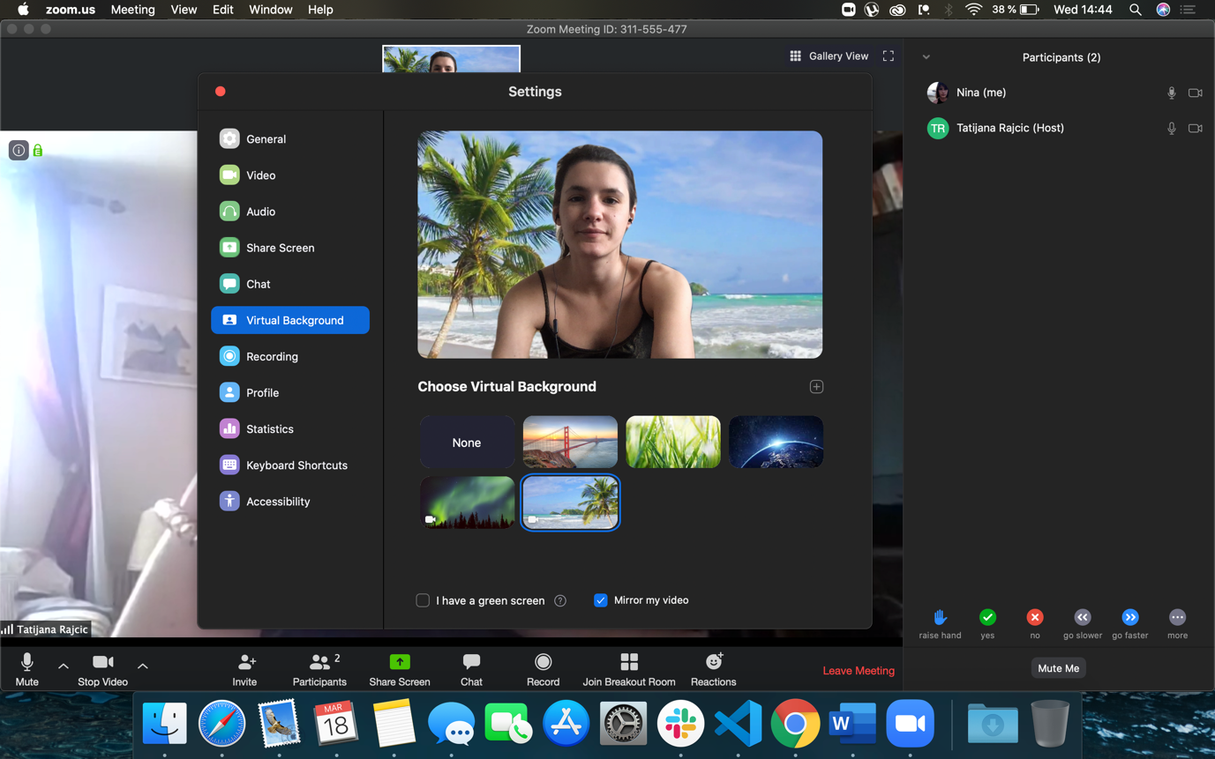
Awesome background
You can customize the background of your video (more coming about that!)

Slide 21
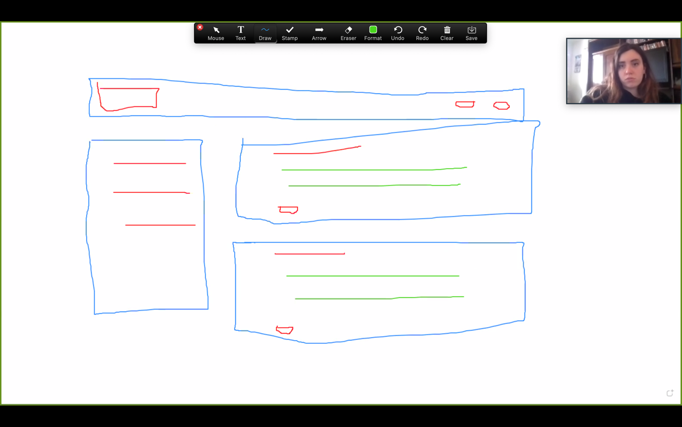
Use whiteboard in groups
You can launch a whiteboard (convenient to share a mock up or explain something that is not code) and people of the room can put annotations to complete it

